Slide 1
Computer Networks and the Internet: An Overview
Chapter 1

Slide 2
Roadmap
Internet structure
overview
protocols
core, edge, access
Packet vs circuit switching
Performance metrics
loss, delay, throughput
Internet layers

Slide 3
















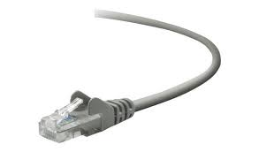
The Internet: "a network engineer" view
Billions of connected computing devices:
hosts = end systems
running network apps at Internet’s “edge”
mobile network
national or global ISP
Packet switches: forward packets (chunks of data)
routers, switches
local or regional ISP
Internet
Communication links
fiber, copper, radio, satellite
transmission rate: bandwidth
home network
content
provider
network
datacenter
network
Networks
collection of devices, routers, links: managed by an organization
enterprise
network
Notes:
View 1: The Internet behind the scenes: end devices, routing devices, links, protocols, etc.
Main players: AT&T, Verizon, Akamai, etc. Access providers.

Slide 4
The Internet: "a network engineer" view
mobile network
4G
"network of networks"
protocols are everywhere:
control sending, receiving of messages
e.g., HTTP, Skype, TCP, IP, WiFi, 4G/5G, Ethernet
standards
protocol ~ algorithm
standard ~ template, objectives
important standardization bodies: RFC, IETF, IEEE
national or global ISP
IP
Streaming
video
Skype
local or regional ISP
home network
content
provider
network
HTTP
datacenter
network
Ethernet
TCP
enterprise
network
WiFi
Notes:
Standards vs protocols:
Standards are broad descriptions/specifications of how systems should work. Think of standards as blueprints.
Protocols are a specific set of rules that govern the exchange of data between devices. Think of protocols as detailed instructions based on a blueprint.
A programming analogy: standards are to documentation what protocols are to algorithms.

Slide 5
The Internet: "a software engineer" view
mobile network
Infrastructure that provides services to applications:
web, streaming, email, games, social media…
Provides programming interface to distribute applications:
"hooks" allowing apps to send/receive messages (e.g., socket programming)
"service options," analogous to postal service (e.g., reliable vs unreliable data transfer)
national or global ISP
Streaming
video
Skype
local or regional ISP
home network
content
provider
network
HTTP
datacenter
network
enterprise
network
Notes:
View 2: The Internet as a platform to provide services.
Analogy: Think of an API. One can use the Internet through its "APIs" to provide services.
Main players: Netflix, Facebook/Meta, etc. Content providers.
This course is comprehensive and explores both views.

Slide 6
What’s a protocol?
Human protocols:
“what’s the time?”
“I have a question”
introductions
Network protocols:
computers (devices) rather than humans
all communication activity in Internet governed by protocols
Rules for:
… specific messages sent
… specific actions taken when message received, or other events
Protocols define the format, order of messages sent and received among network entities, and actions taken on message transmission, receipt
Notes:
Can you think of any other human protocols?
Can you think of any computing protocols?
Why do we need this many protocols, both for humans and computers?

Slide 7



What’s a protocol?
A human protocol and a computer network protocol:
Hi
TCP connection
request
Hi
TCP connection
response
Got the
time?
GET http://gaia.cs.umass.edu/kurose_ross
2:00
<file>
time
Notes:
Explain important points
distributed entities, exchanging messages (governed by protocols)
Time going down
go over definition of protocol (showing format, order of messages sent and received, and actions taken)
We’ll see these kinds of diagrams a lot

Slide 8
Internet structure
Definition: ISP (Internet Service Provider): entity/organization that manages a given network
mobile network
network core:
mesh of interconnected routers, networks
network edge:
hosts: clients and servers
servers often in data centers
access network:
wired, wireless links
often used to describe last-mile links (e.g., WiFi, 4G/5G, DSL)
national or global ISP
local or regional ISP
home network
content
provider
network
datacenter
network
enterprise
network

Slide 9
Internet structure
mobile network
network core:
mesh of interconnected routers, networks
network edge:
hosts: clients and servers
servers often in data centers
access network:
wired, wireless links
often used to describe last-mile links (e.g., WiFi, 4G/5G, DSL)
national or global ISP
local or regional ISP
home network
content
provider
network
datacenter
network
enterprise
network

Slide 10
Internet structure
mobile network
network core:
mesh of interconnected routers, networks
network edge:
hosts: clients and servers
servers often in data centers
access network:
wired, wireless links
often used to describe last-mile links (e.g., WiFi, 4G/5G, DSL)
national or global ISP
local or regional ISP
home network
content
provider
network
datacenter
network
enterprise
network

Slide 11
Data transfer: Two broad approaches
1- Circuit switching:
resources reserved for "call" between source and destination
pre-defined route to destination
guaranteed performance
data often transmitted in streams

Slide 12
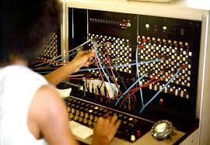
How to reserve resources?
Old telephone systems:
telephone operator physically interconnected source and destination
reserved, exclusive link between end devices
Telephone exchange

Slide 13
How to reserve resources?
4 users
Modern approaches:
Frequency Division Multiplexing (FDM)
optical, electromagnetic frequencies divided into narrow frequency bands
each call/user allocated its own band
Time Division Multiplexing (TDM)
time divided into slots
each call/user allocated periodic slots
frequency
time
frequency
time

Slide 14



Data transfer: Two broad approaches
2- Packet switching: store-and-forward
hosts break messages into packets
packets are stored and forwarded one at a time (e.g., first-in, first-out)
no resource reservation; no pre-defined route to destination
no performance guarantees
L bits
per packet
source
3
2
1
router
destination
R bps
R bps

Slide 15
Circuit switching vs Packet switching
1 Gbps link
each user:
needs 100 Mbps when "active"
active 10% of time
Q: How many users can be served using circuit switching?
…..
N
users
1 Gbps link
A: 10 users

Slide 16
Circuit switching vs Packet switching
1 Gbps link
each user:
needs 100 Mbps when "active"
active 10% of time
Q: How many users can be served using packet switching?
…..
N
users
1 Gbps link
A: with 35 users, probability > 10 active users at same time is less than 0.004.

Slide 17
Is packet switching a winner?
The Internet uses packet switching.
Pros | Cons
great for bursty data (sometimes has data to send, sometimes does not) resource sharing simple (no "call" setup) | excessive congestions possible no performance guarantees

Slide 18
Packet switching: Queueing
R = 100 Mb/s
C
A
R = 1.5 Mb/s
D
B
E
queue of packets
waiting for transmission over output link
What if more than one user is active at a time? If arrival rate (in bps) to link exceeds transmission rate (bps) of link for some time:
packets will queue, waiting to be transmitted on output link
packets can be dropped (lost) if memory (buffer) in router fills up

Slide 19
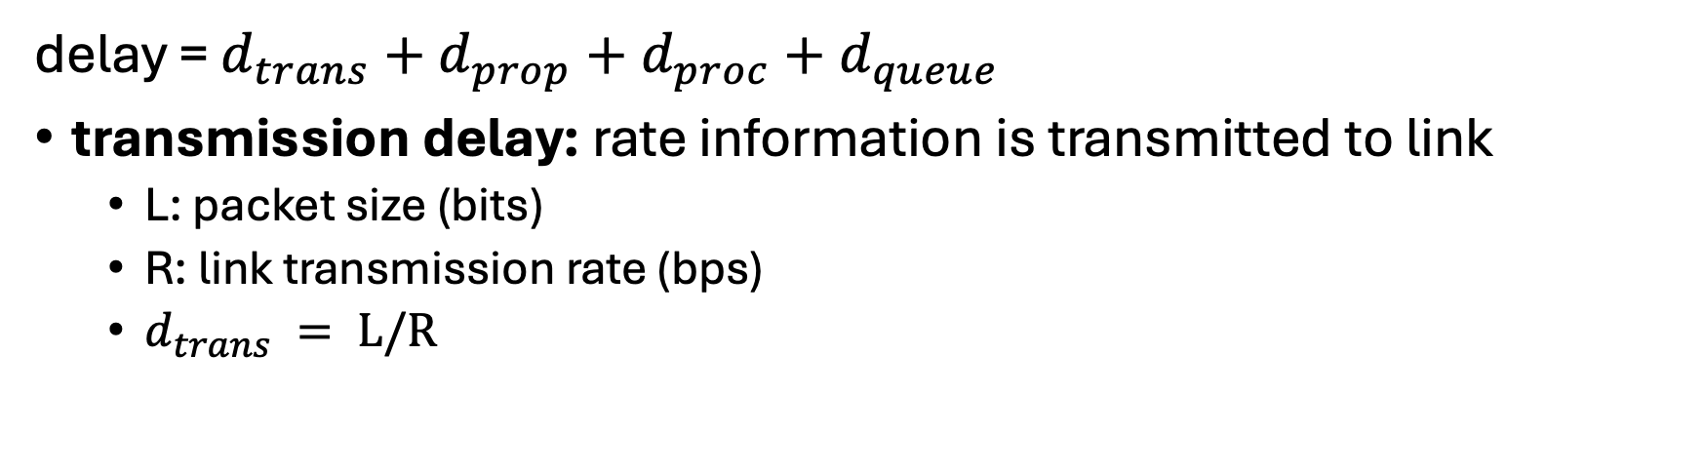
How packet delay occurs?
transmission
A
propagation
B
nodal
processing
queueing
delay = $d_{trans}+d_{prop}+d_{proc}+d_{queue}$
transmission delay: rate information is transmitted to link
L: packet size (bits)
R: link transmission rate (bps)
$d_{trans} = L/R$

Slide 20
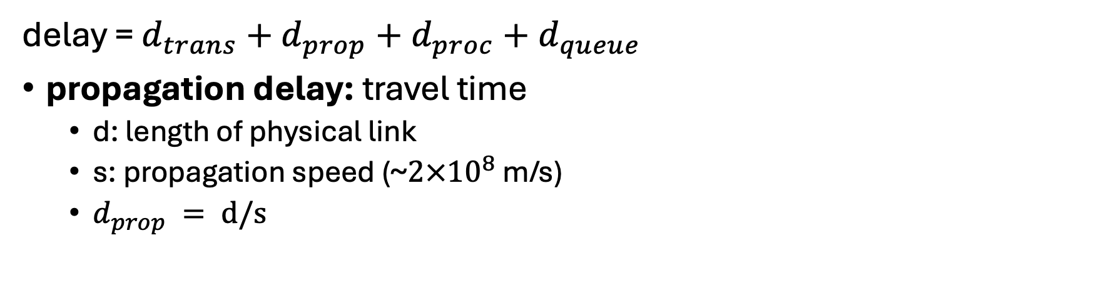
How packet delay occurs?
transmission
A
propagation
B
nodal
processing
queueing
delay = $d_{trans}+d_{prop}+d_{proc}+d_{queue}$
propagation delay: travel time
d: length of physical link
s: propagation speed (~$2×{10}^{8}$ m/s)
$d_{prop} = d/s$

Slide 21
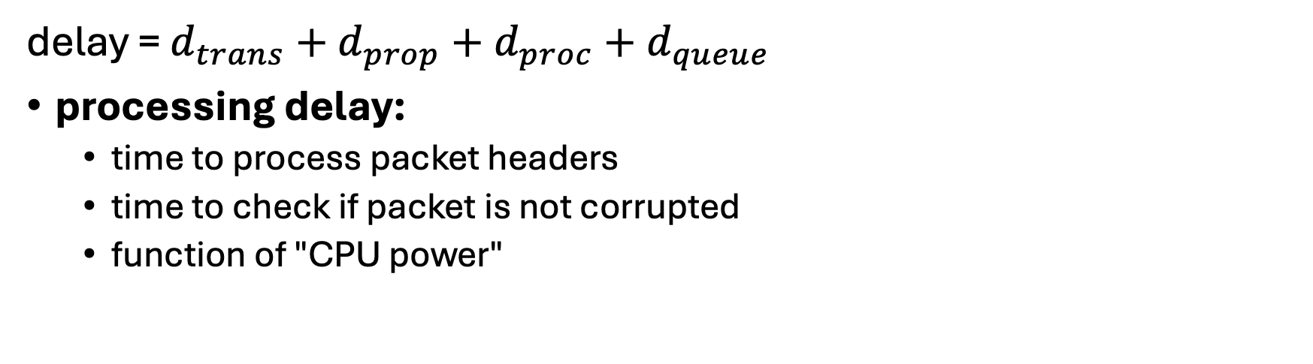
How packet delay occurs?
transmission
A
propagation
B
nodal
processing
queueing
delay = $d_{trans}+d_{prop}+d_{proc}+d_{queue}$
processing delay:
time to process packet headers
time to check if packet is not corrupted
function of "CPU power"

Slide 22

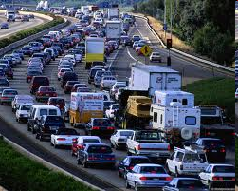
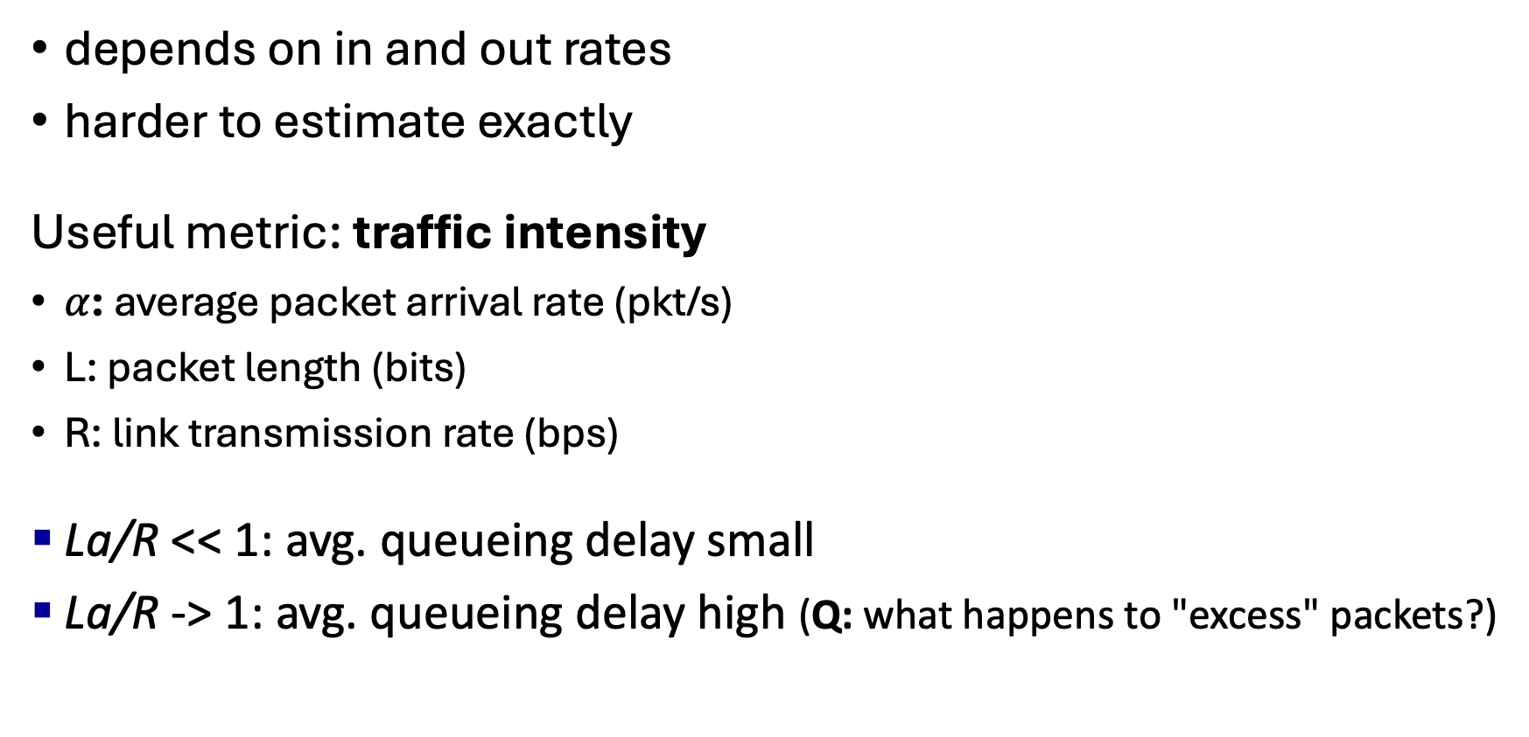
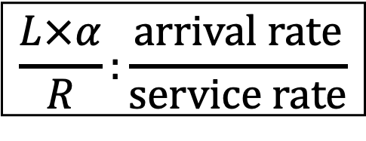
Queueing delay
depends on in and out rates
harder to estimate exactly
Useful metric: traffic intensity
$α$: average packet arrival rate (pkt/s)
L: packet length (bits)
R: link transmission rate (bps)
La/R << 1: avg. queueing delay small
La/R -> 1: avg. queueing delay high (Q: what happens to "excess" packets?)
La/R << 1
$$\frac{L×α}{R}:\frac{\text{arrival} \text{rate}}{\text{service} \text{rate}}$$
La/R -> 1

Slide 23
"Real" Internet delays and routes
traceroute program:
sends 3 packets that will reach router i on path towards destination
router i will return packets to sender
sender measures time interval between transmission and reply
3 probes
3 probes
3 probes

Slide 24
Real Internet delays and routes
traceroute: gaia.cs.umass.edu to www.eurecom.fr
3 delay measurements from
gaia.cs.umass.edu to cs-gw.cs.umass.edu
1 cs-gw (128.119.240.254) 1 ms 1 ms 2 ms
2 border1-rt-fa5-1-0.gw.umass.edu (128.119.3.145) 1 ms 1 ms 2 ms
3 cht-vbns.gw.umass.edu (128.119.3.130) 6 ms 5 ms 5 ms
4 jn1-at1-0-0-19.wor.vbns.net (204.147.132.129) 16 ms 11 ms 13 ms
5 jn1-so7-0-0-0.wae.vbns.net (204.147.136.136) 21 ms 18 ms 18 ms
6 abilene-vbns.abilene.ucaid.edu (198.32.11.9) 22 ms 18 ms 22 ms
7 nycm-wash.abilene.ucaid.edu (198.32.8.46) 22 ms 22 ms 22 ms
8 62.40.103.253 (62.40.103.253) 104 ms 109 ms 106 ms
9 de2-1.de1.de.geant.net (62.40.96.129) 109 ms 102 ms 104 ms
10 de.fr1.fr.geant.net (62.40.96.50) 113 ms 121 ms 114 ms
11 renater-gw.fr1.fr.geant.net (62.40.103.54) 112 ms 114 ms 112 ms
12 nio-n2.cssi.renater.fr (193.51.206.13) 111 ms 114 ms 116 ms
13 nice.cssi.renater.fr (195.220.98.102) 123 ms 125 ms 124 ms
14 r3t2-nice.cssi.renater.fr (195.220.98.110) 126 ms 126 ms 124 ms
15 eurecom-valbonne.r3t2.ft.net (193.48.50.54) 135 ms 128 ms 133 ms
16 194.214.211.25 (194.214.211.25) 126 ms 128 ms 126 ms
17 * * *
18 * * *
19 fantasia.eurecom.fr (193.55.113.142) 132 ms 128 ms 136 ms
3 delay measurements
to border1-rt-fa5-1-0.gw.umass.edu
trans-oceanic link
looks like delays decrease! Why?
* means no response (probe lost, router not replying)
* Do some traceroutes from exotic countries at www.traceroute.org

Slide 25
Throughput
average rate (bits/time unit) at which bits are being sent from sender to receiver
analogy: water pipes
link capacity
R_{s} bits/sec
link capacity
R_{c} bits/sec
server sends bits
(fluid) into pipe
(i.e., pipe that can carry
fluid at rate R_{s})

Slide 26
Throughput
R_{s} < R_{c} What is average end-end throughput?
R_{s} bits/sec
R_{c} bits/sec
R_{s} > R_{c} What is average end-end throughput?
R_{s} bits/sec
R_{c} bits/sec
bottleneck link
link on end-end path that constrains end-end throughput

Slide 27
Throughput: network scenario
per-connection end-end throughput: min(R_{c},R_{s},R/10)
in practice: R_{c} or R_{s} is often bottleneck
R_{s}
R_{s}
R_{s}
R
R_{c}
R_{c}
R_{c}
10 connections (fairly) share backbone bottleneck link R bits/sec

Slide 28
Layered Internet protocol stack
application: supporting network applications
HTTP, IMAP, SMTP, DNS
transport: process-process data transfer
TCP, UDP
network: routing of datagrams from source to destination
IP, routing protocols
link: data transfer between neighboring network elements
Ethernet, 802.11 (WiFi), PPP
physical: bits “on the wire”
application
application
transport
transport
network
network
link
link
physical
physical

Slide 29
Why layering?
Layering is a common approach to designing complex systems. The explicit, modular structure
allows identifying relationship of system's pieces
eases maintenance, updating system

Slide 30





Encapsulation
Matryoshka dolls (stacking dolls)
message
segment
datagram
frame
Credit: https://dribbble.com/shots/7182188-Babushka-Boi
Notes:
Thanks to Nikko Bovornkeeratiroj, Phuthipong <phuthipong@cs.umass.edu>, for the stacking dolls idea and slides

Slide 31
Services, Layering and Encapsulation
application
transport
network
link
physical
M
application
transport
network
link
physical
Application exchanges messages to implement some application service using services of transport layer
H_{t}
M
Transport-layer protocol transfers M (e.g., reliably) from one process to another, using services of network layer
transport-layer protocol encapsulates application-layer message, M, with transport layer-layer header H_{t} to create a transport-layer segment
H_{t} used by transport layer protocol to implement its service
source
destination

Slide 32
Services, Layering and Encapsulation
application
transport
network
link
physical
M
application
transport
network
link
physical
H_{t}
M
Transport-layer protocol transfers M (e.g., reliably) from one process to another, using services of network layer
H_{n}
H_{t}
M
Network-layer protocol transfers transport-layer segment [H_{t} | M] from one host to another, using link layer services
network-layer protocol encapsulates transport-layer segment [H_{t} | M] with network layer-layer header H_{n} to create a network-layer datagram
H_{n} used by network layer protocol to implement its service
source
destination

Slide 33
Services, Layering and Encapsulation
H_{n}
H_{t}
M
application
transport
network
link
physical
M
application
transport
network
link
physical
H_{t}
M
H_{n}
H_{t}
M
Network-layer protocol transfers transport-layer segment [H_{t} | M] from one host to another, using link layer services
H_{l}
H_{n}
H_{t}
M
Link-layer protocol transfers datagram [H_{n}| [H_{t} |M] from host to neighboring host, using network-layer services
link-layer protocol encapsulates network datagram [H_{n}| [H_{t} |M], with link-layer header H_{l} to create a link-layer frame
source
destination

